Slide 1
Affirmative Abrasion: Friction Materials and Industrial Braking Systems Demystified
Chris Koralik
Kor-Pak Corporation

Slide 2
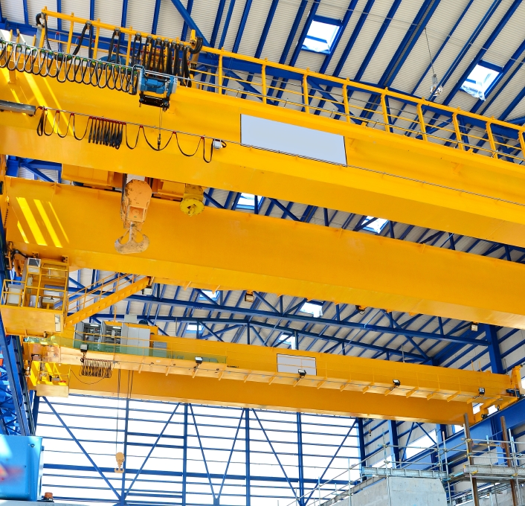
Impetus and Introduction
Every EOT Crane needs brakes
Several variables involved in brake selection and accurately specifying brake
Not all brakes are created equally
Primary purpose: increased safety and efficiency to obtain greater uptime for crane, provide education and assistance for brake design, selection, and analysis

Slide 3
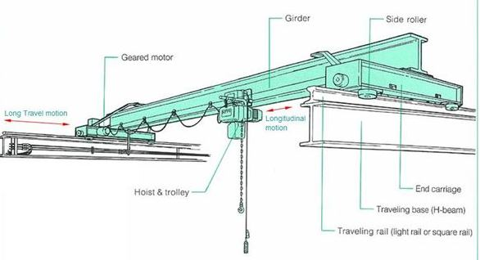
EOT Crane Brakes: Fundamentals
Three Primary Motions: Bridge, Trolley, and Hoist
Fail-Safe
Spring-Applied
DC Magnet
AC Thruster
Drum and Disc
AISE standard sizes
EOT Crane Motions
Notes:
In steel and iron-making applications, industrial cranes perform three main motions: forward movement along the X Axis which is referred to as bridge motion, lateral/left-right movement along the Y Axis which is referred to as Trolley Motion, and up/down movement along the Z axis which is referred to as Hoist Motion
fail-safe: a spring releases to “set” or apply the brake when power is interrupted. This effectively prevents loads from moving or falling during power failures. The brake is released through the DC-powered magnetic coil, which is either shunt or series-wound. The brake is set when force is applied to the brake drum, which reduces or stops shaft rotation. In this way, a ladle loaded with molten steel can be prevented from falling vertically or making unsafe bridge or trolley movements.

Slide 4
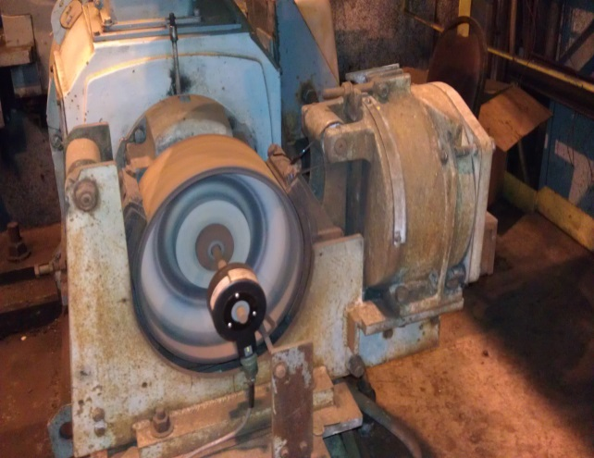
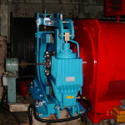
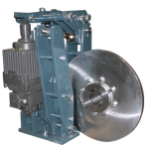
Understanding the Numbers
Electrical (full motor) Torque
Torque=(HP X 5250)/RPM
Mechanical Braking Torque
Torque=AF X 0.42(D-F)/24 (2)
Service Factor
Maximum torque value produced by brake
Must be sufficient to overcome full motor torque
Gearbox
Notes:
A critical variable involved in calculating the specifications of a given braking application is torque. Torque can be defined as, A measurement of the propensity of a given force to cause the object upon which it acts to twist about a certain axis. The torque is simply the product of the magnitude of the Applied Force and the length of the lever arm.
Motor Torque is an electrical formula which refers to the maximum load the motor can produce. The following is the formula for motor torque which uses the horsepower and RPM of the motor being used and is expressed in Foot Pounds (Lb X Ft)
Mechanical braking torque measures the maximum torque value that can be generated by the brake and it is a calculation of the rotational (torque) value that is yielded by the amount of Applied Force it has. Force comes from the mechanism of the brake which is the compression spring plus the mechanical advantage (lever ratio). In other words, Applied Force is the product of force times distance and is calculated by multiplying the spring force times the mechanical ratio (which is determined by the brake design). Mechanical braking torque measures the maximum torque value that can be generated by the brake and it is a calculation of the rotational (torque) value that is yielded by the amount of Applied Force it has. Fundamentally, torque is a rotational force and Applied Force is a linear force.

Slide 5
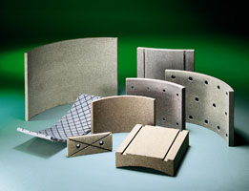
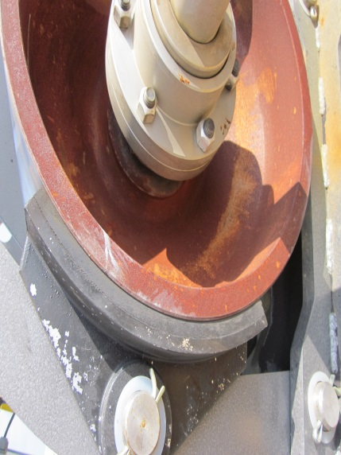
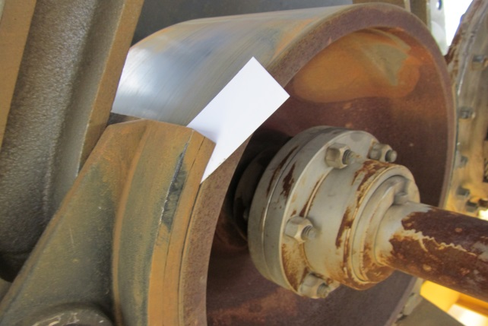
Friction: More art Than Science
Friction Coefficient
Definition: The coefficient of friction between two surfaces in contact is equal to the force required to overcome the friction divided by the reaction force between the two surfaces
Formula: $μ = F /R$
Real vs. Nominal Friction Coefficient
.42 is arbitrary value
Factors that affect friction coefficient (burnishing, contamination, static vs. dynamic)
Burnishing
Brake Fade
Before Burnishing
After Burnishing
Notes:
The 0.42 coefficient of friction value is an ideal standard which could be considered the “nominal” friction coefficient. This nominal friction coefficient makes a number of assumptions, including but not limited to the brake being used in a dynamic application, the brake being operated in clean environmental conditions, and whether or not the friction linings are adequately burnished, among others.
. A dynamic stopping application will generally have a higher friction coefficient than its static counterpart. In a static application, the braking starts from a stationary position; the lining will not achieve full contact on the disc/drum because there will be high points/ridges on the linings (static de-rated approx. 20% of value)
Brake/pad fade occurs when the temperature at the interface between the pad and the disc exceeds the thermal capacity of the pad. One result of brake fade is the formation of resin components on the linings commonly referred to as “glazing” which effectively reduces the integrity of the linings and thus lowers the coefficient of friction of the linings. This is typically indicated with a telltale odor and/or smoke. Fluid boiling and vaporization is another result of brake fade which has adverse effect on friction coefficient and ultimately the ability for the brake to stop. Gas bubbles are formed when fluid boils on the friction materials and ultimately degrade the ability for the friction material to interface with the disc/drum. This process is incremental with several warning signs
Since brake fade occurs as a result of continuous braking and the heat that ensues, decreasing the stopping/braking time is the principal means to mitigate the risk of brake fade. Stopping time is directly proportionate to the amount of heat generated during the friction occurrence. In other words, if stopping time is decreased from four seconds to two seconds, heat generation is reduced by fifty percent. Less heat means less pad/shoe wear. One way to reduce stopping time is by increasing the torque of the brake. As discussed, the variables that can be manipulated to create variation in the torque formulate are disc diameter, friction coefficient, and Applied Force of the brake. By using a larger disc, using friction linings/pads with a higher coefficient of friction, or using a brake with a greater amount of Applied Force will yield a higher torque value. Contrary to popular belief, increasing pad area will not increase the brake torque
Burnishing is therefore a method of preconditioning the brake lining rendering it ready for full service upon installation. The user is in a position to install and drive without having to follow complicated bedding-in procedures, although a certain amount of "self-bedding-in" is still present

Slide 6
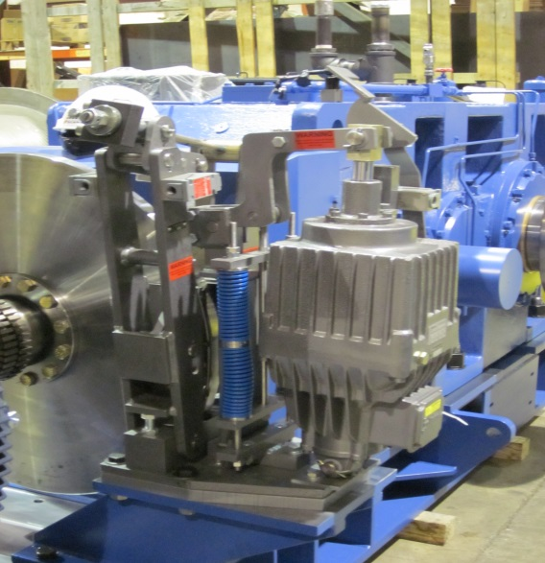
Size Does Not Necessarily Matter
Brake size is not the only contributing factor to mechanical braking torque: friction coefficient have a material impact on overall torque
Given: 100 HP Motor, 1800 RPM, 10:1 Gearbox ratio, Low-speed side
Case Study
Braking Torque Variables | Scenario #1 | Scenario #2
Disc Diameter | 28” | 31.5”
Applied Force | 12,100 Lb | 8,520 Lb
Friction Coefficient | 0.40 | 0.60
Mechanical Braking Torque | 4,698.83 Lb-Ft | 5,985.30 Lb-Ft
Notes:
This brake that is more than capable of handling this torque value. In fact, the disc diameter can be decreased to 24" and still generate 4,387.80 Lb. Ft. of torque, which is more than sufficient for the given application. This solution has the added advantage of requiring less clearance the 28" disc and provides a degree of cost savings, as well.
The implication of these scenarios is critical: if a torque calculation for a given brake uses the nominal coefficient of friction (0.42) without taking other variables into consideration, there is the potential for the brake to underperform. A 0.05 decrease in friction coefficient may not necessarily yield a substantive difference, but in some cases it could reduce the torque value to the point of not being capable of carrying the load and thus the results would become catastrophic. Additionally, stopping power varies as a result of the application.
Different stopping power ideal for trolley vs. hoise (gradual vs. hard stop)

Slide 7
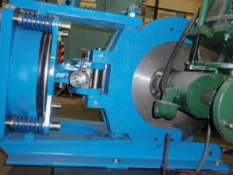
Not all brakes are created equally
Brake Type | Strengths | Weaknesses
Magnet Brake | Clean, Few moving parts, | Not easily adjustable, smaller stroke/air gap, “On/Off”
AC Thruster Brake | Scalable torque tube, easily adjustable, ease of maintenance, lowering valve gradual ramping, lining wear indicators, mechanical limit switches
Disc Brake | Range of disc diameters to vary torque, greater contact=greater friction
Drum Brake | Long history, familiarity | Curved shoes=less contact
Balanced Load Disc Brake | Contact disc in symmetrical and opposite points, no vibrational issues or external loads on shaft

Slide 8
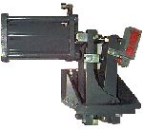
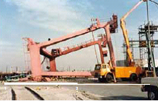
Storm Brakes: Protecting Your Crane Against the Elements
Variety of Storm Brakes (Rail Clamps) available in a range of holding capacities 1000 to 150000 lbs
Protection against 80+ MPH wind velocities
The Tripper Gripper Rail Clamp System for position holding, emergency stopping, and / or emergency lock down
Notes:
The Tripper Gripper Rail Clamp System is typically utilized on small cranes and trippers for position holding, emergency stopping, and / or emergency lock down. These Rail Clamps are offered in hydraulic, pneumatic, manual, and eland electric versions

Slide 9
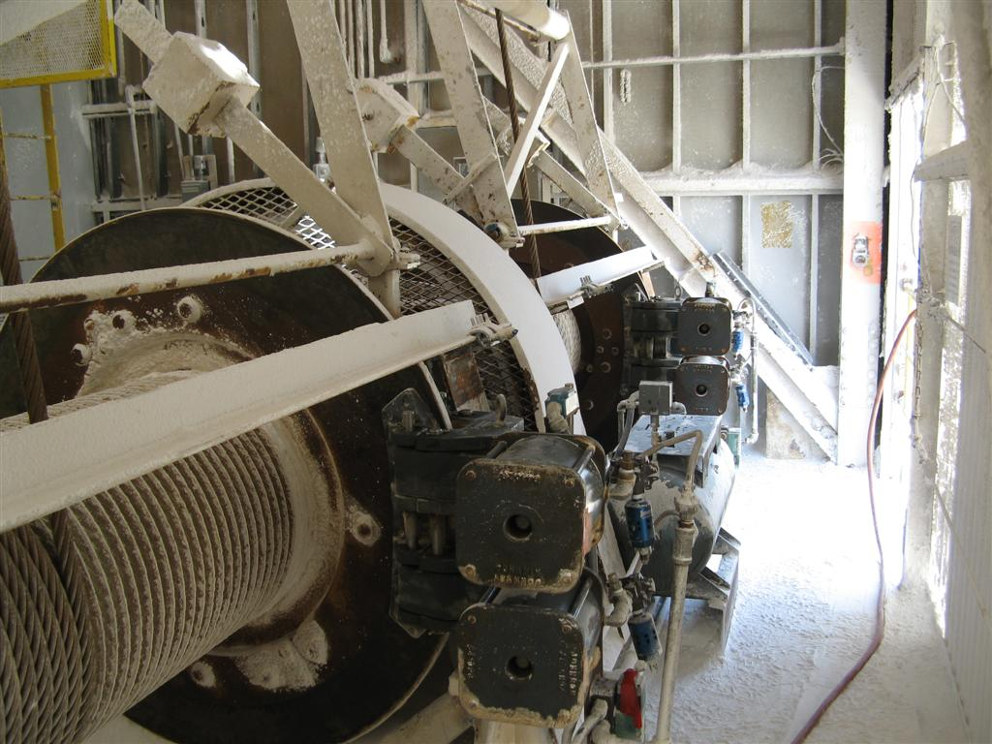
Emergency Brakes: The Optimal Safety for EOT Cranes
Extraordinary circumstances preclude primary and secondary braking systems from stopping a load
Low-speed failures: shaft breaking, gearbox or coupling failure
Solution: Emergency duty caliper disc brakes on drum

Slide 10
Typical Hoist Brake Setup

Slide 11
The Proactive Approach to Safety
Preventive measure to rare but catastrophic failures
Rotating disc attached to drum
Brakes possess sufficient torque to stop entire load
In event of emergency
Fail-safe, hydraulic, air, or magnet release
No formal US Standards require E-Brakes
Andrew Pimblett, “Breaking the
Taboo”
Should E-Brakes
be optional?
Costs vs. Benefits
Notes:
“Breaking the taboo” Andrew Pimblett, Managing Director of Street Crane says, “In Europe the crane design standards have recently become far more prescriptive with regard to ensuring the safety of personnel in certain steel mill crane applications. For example, cranes for ‘lifting and transporting hot molten masses’ must now be designed in such a way that in the event of a structural component failing in the kinetic chain the load is prevented from falling. This makes it mandatory to fit emergency brakes which act on the hoist drum in the event of a failure in the hoist transmission. Mandatory ‘safety categories’ have also been introduced for crane control systems involving electronics

Slide 12
Pleasure to serve the AIST
Thank you for your time. Please feel free to contact me with any questions:
christopher@kor-pak.com
(847) 226-9397

